Slide 1

Unit-III Socio-organizational issues and stakeholder requirements

Slide 2
Socio-organizational issues and stakeholder requirements
Organizational issues affect acceptance
– conflict & power, who benefits, encouraging use
Stakeholders
– identify their requirements in organizational context
• Socio-technical models
– human and technical requirements
• Soft systems methodology
– broader view of human and organizational issues
• Participatory design
– includes the user directly in the design process
• Ethnographic methods
– study users in context, unbiased perspective

Slide 3
Organizational issues
Organisational factors can make or break a system. Studying the work group is not sufficient
any system is used within a wider context
and the crucial people need not be direct users
Before installing a new system must understand:
who benefits
who puts in effort
the balance of power in the organisation
… and how it will be affected
Even when a system is successful
… it may be difficult to measure that success

Slide 4
Conflict and power
CSCW = Computer Supported Cooperative Work
people and groups have conflicting goals
systems assuming cooperation will fail!
e.g. computerise stock control
stockman looses control of information
subverts the system
identify stakeholders – not just the users

Slide 5
Organisational structures
Groupware affects organisational structures
communication structures reflect line management
email – cross-organisational communication
Disenfranchises lower management
disaffected staff and ‘sabotage’
Technology can be used to change management style and power structures
but need to know that is what we are doing
and more often an accident !

Slide 6
Invisible workers
Telecommunications improvements allow:
neighbourhood workcentres
home-based tele-working
Many ecological and economic benefits
reduce car travel
flexible family commitments
but:
‘management by presence’ doesn't work
presence increases perceived worth
problems for promotion
Barriers to tele-working are managerial/social
not technological

Slide 7
Benefits for all?
Disproportionate effort
who puts in the effort ≠ who gets the benefit
Example: shared diary:
effort: secretaries and subordinates, enter data
benefit: manager easy to arrange meetings
result: falls into disuse
Solutions: coerce use, design in symmetry
Free rider problem
no bias, but still problem
possible to get benefit without doing work if everyone does it, system falls into disuse
e.g. electronic conferences (read but never contribute)
solutions: strict protocols, increase visibility (social pressure)

Slide 8
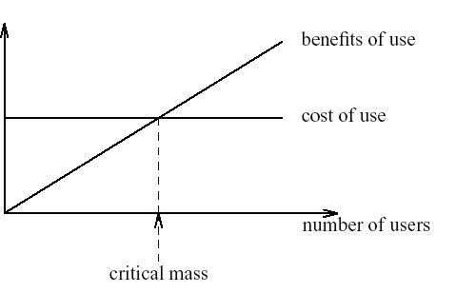
Critical mass
Early telephone system:
few subscribers – no one to ring
lots of subscribers – never stops ringing!
Electronic communications similar:
benefit is proportional to number of subscribers
early users have negative cost/benefit need critical mass to give net benefits
How to get started?
look for cliques to form core user base
design to benefit an initial small user base

Slide 9
Evaluating the benefits
Assuming we have avoided the pitfalls!
How do we measure our success?
job satisfaction and information flow
hard to measure
economic benefit
diffuse throughout organisation
But ..
costs of hardware and software
… only too obvious
Perhaps we have to rely on hype!

Slide 10
capturing requirements
need to identify requirements within context of use
need to take account of
stakeholders
work groups and practices
organisational context
many approaches including
socio-technical modelling
soft system modelling
participatory design
contextual inquiry

Slide 11
who are the stakeholders?
System will have many stakeholders with potentially conflicting interests
stakeholder is anyone effected by success or failure of system
primary - actually use system
secondary - receive output or provide input
tertiary - no direct involvement but effected by success or failure
facilitating - involved in development or deployment of system

Slide 12
who are the stakeholders?
Example: Classifying stakeholders – an airline booking system
An international airline is considering introducing a new booking system for use by associated travel agents to sell flights ticket directly to the public.
Primary stakeholders: travel agency staff, airline booking staff
Secondary stakeholders: customers, airline management
Tertiary stakeholders: competitors, civil aviation authorities, customers’ travelling companions, airline shareholders
Facilitating stakeholders: design team, IT department staff

Slide 13
who are the stakeholders?
Designers need to meet as many stakeholder needs as possible
usually in conflict so have to prioritise
often priority decreases as move down categories e.g. primary most important
not always e.g. life support machine

Slide 14
Socio-technical modelling
Response to technological determinism (view that social change is determined by technology)
In contrast socio-technical systems view focuses on inter- relationship of human and machine elements
Human issues should not be overwhelmed by technical considerations
concerned with technical, social, organizational and human aspects of design
Describes impact of specific technology on organization
Information gathering: interviews, observation, focus groups, document analysis
several approaches e.g.
CUSTOM, OSTA

Slide 15
CUSTOM methodology
CUSTOM is a socio-technical methodology designed to be practical to use in small organizations.
It is based on the User Skills and Task Match (USTM) approach, developed to allow design teams to understand and fully document user requirements
six key stages

Slide 16
CUSTOM
Six stage process - focus on stakeholders
Describe organizational context - including primary goals, physical characteristics, political and economic background
Identify and describe stakeholders - including personal issues, role in the organization and job
Identify and describe work-groups whether formally constituted or not
Identify and describe task–object pairs i.e. tasks to be performed and objects used
identify stakeholder needs: stages 2–4 described in terms of both current and proposed system - stakeholder needs are identified from the differences between the two
consolidate and check stakeholder requirements against earlier criteria

Slide 17
Open System Task Analysis (OSTA)
To describe what happens when a technical system is introduced into an organizational work environment.
OSTA focus on tasks, OSTA has eight main stages
Technology must support is identified in terms of users’ goals.
Task inputs to the system are identified.
The external environment - physical, economic and political aspects.
The transformation processes within the system are described.
The social system is analyzed.
The technical system is described -configuration and integration with other systems.
Performance satisfaction criteria are established.
The new technical system is specified

Slide 18
Soft systems methodology
No assumption of technological solution - emphasis on understanding situation fully
It was developed by Checkland
seven stages
recognition of problem and initiation of analysis
detailed description of problem situation
rich picture
generate root definitions of system
CATWOE (customers, actors, transformation process, worldview, owners and environmental constraints)
conceptual model - identifying transformations
compare real world to conceptual model
identify necessary changes
determine actions to effect changes

Slide 19



Soft systems methodology
Technology and people are components.
The rich picture can be in any style – there are no right or wrong answers – but it should be clear and informative to the designer.
Speech balloons are used to represent stakeholder issues;
Crossed swords represent conflicts within the system;
The eye represents external influences or observers

Slide 20
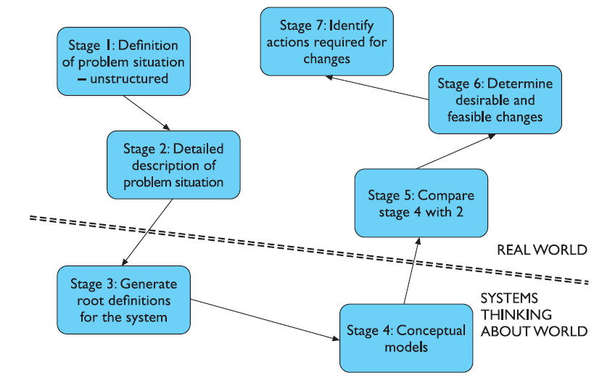
seven stages of soft systems methodology

Slide 21
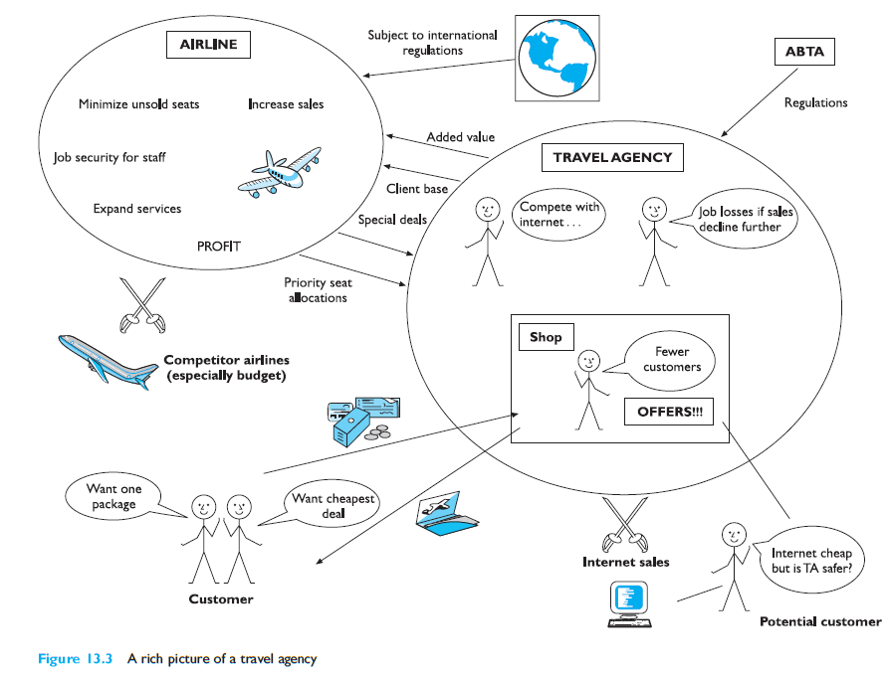
Soft systems methodology

Slide 22
an airline booking system
Client: customer
Actor: travel agency staff
Transformation: customer’s intention and request to travel transformed into sale of seat on flight and profit for organization
Weltanschauung: profits can be optimized by more efficient sales
Owner: airline management
Environment: Regulations of international civil aviation authorities and national contract legislation.
Local agency policies worldwide

Slide 23
Participatory design
someone to be consulted when necessary
passive participants whose involvement is entirely governed by the designer.
Three specific characteristics
To improve the work environment and task by the introduction of the design
Collaboration: the user is included in the design team and can contribute to every stage of the design
iterative

Slide 24
Participatory design
In participatory design:
workers enter into design context
In ethnography (as used for design): designer enters into work context
Both make workers feel valued in design
… encourage workers to ‘own’ the products

Slide 25
Participatory Design
User is an active member of the design team.
Characteristics
context and work oriented rather than system oriented
collaborative
iterative
Methods
brain-storming
storyboarding
workshops
pencil and paper exercises

Slide 26
Participatory design methods
stakeholders are included as participants in the decision making process.
system development as one of managing change:
conflicts will occur and must be negotiated to ensure acceptance and satisfaction with the system
Three levels of participation
Consultative – weakest form , asked for their opinions but are not decision makers.
Representative – a representative of the participant group is involved in the decision making process.
Consensus – all stakeholders are included in the decision-making process

Slide 27
Participatory design methods
The design groups then address the following issues
Make the case for change
Identify system boundaries
Describe the existing system
Define key objectives
Define key tasks
Define key information needs
Diagnose efficiency needs
Diagnose job satisfaction needs
Analyze likely future changes
Specify and prioritize objectives based on efficiency

Slide 28
Ethnographic methods
Focus of this has been on gathering stakeholder perspectives
understand the situation from within its own cultural framework
Culture here means that of the particular workgroup or organization, rather than that of society as a whole.

Slide 29
Ethnographic methods
Contextual inquiry
it studies the user in context, trying to capture the reality of his work culture and practice.
Interviews take place in the workplace so that the objects, artifacts and relationships of the work can be better understood.
Contextual inquiry focuses on a 2–3 hour interview with the user in the workplace.
The idea is to capture and record as much detail as possible, including what
The user says and does (step by step), how he communicates, coordinates with others, his feelings.

Slide 30
ETHICS (Effective Technical and Human Implementation of Computer-based Systems)
participatory socio-technical approach devised by Mumford
system development is about managing change
non-participants more likely to be dissatisfied
three levels of participation
consultative, representative, consensus
design groups including stakeholder representatives make design decisions
job satisfaction is key to solution

Slide 31
Ethnography
very influential in CSCW
a form of anthropological study with special focus on social relationships
does not enter actively into situation seeks to understand social culture unbiased and open ended

Slide 32
contextual inquiry
Approach developed by Holtzblatt
in ethnographic tradition but acknowledges and challenges investigator focus
model of investigator being apprenticed to user to learn about work
investigation takes place in workplace - detailed interviews, observation, analysis of communications, physical workplace, artefacts
number of models created:
sequence, physical, flow, cultural, artefact
models consolidated across users
output indicates task sequences, artefacts and communication channels needed and physical and cultural constraints

